Slide 1
Week 4 progress

Slide 2
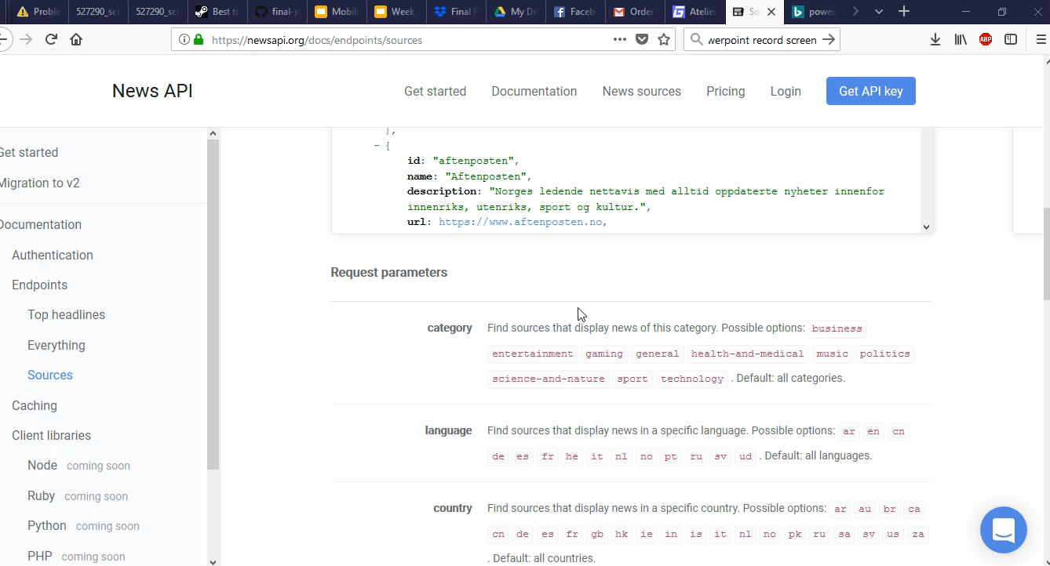
Demo

Slide 3
Screenshots

Slide 4
What we have done
Robert: Created Loaders and Adapters for categories
Chirs: Bug fixes
Jacob: User history

Slide 5
What needs to be done
Make a search bar to search for topics.
Finish history DB
Finish menu for catagories

